Slide 1
Data Stream Event Prediction Based on Timing Knowledge and State Transitions
산업공학과 ITM전공 김민선

Slide 2
ABSTRACT
새로운 접근 방식을 사용하여 Data stream에서 다가오는 이벤트를 예측하는 연구에 관한 논문
이벤트 시간 순서를 이벤트 엔터티간의 관계유형으로 취급 ->
동적 지식 그래프 작성 ->
향후 이벤트 시기를 예측
시간 경과에 따른 데이터 스트림의 상태를 특성화하기위해 ‘states’ 라는 임시노드의 개념을 도입
기존 방식 대비 이벤트 예측에 있어 정확도 향상
Stream system (graph building, training, event prediction)의 전체 처리량은 초 당 1천에서 6만 튜플이다.

Slide 3
INTRODUCTION
과거 Event matching과 관련하여 많은 연구들이 진행되었지만, target event의 타이밍을 예측하는 연구는 미비하였다. 위 논문은 multi-attribute data stream discrete-event timing prediction을 이용한 더 정확한 예측 모델을 제안한다.
예시
당뇨병 환자의 모니터링 및 관리 :규칙적인 인슐린 용량, NPH 용량, 식전 또는 식후 혈당 측정, 저혈당 증상과 같은 짧은 신호를 튜플로 간주,
유정 및 가스정에서 바람직하지 않은 사건 예측 :PDG의 압력, TPT에서의 온도와 압력 등
교통 영역에서의 사용 :특정 위치에서의 차량 입출입 이벤트 수

Slide 4
Requirements and Approach
Requirements 다른 데이터 스트림 응용 프로그램 및 방법과 일관되게 예측 모델의 학습은 빠르고 실시간으로 수행되어야함, training은 이상적으로 가장 최근의 소량의 데이터만을 사용하여 모델의 학습과 훈련이 데이터 스트림의 모든 변화에 적응할 수 있도록 연속적으로 진행되어야함 (모든 데이터를 중앙서버로 전달하기 보다, 바람직하지 않은 이벤트 모델 학습 및 예측은 각 장치 제자리 에서 수행)
Novel Approach (Graph Embedding) 두개 이벤트 사이의 timing 관계를 특징으로 하는 지식그래프 생성, 특정 시점에서 참으로 유지되는 이벤트를 특성화하는 “active state” 개념을 도입, timing 지식 그래프의 각 활성 세트와 연관된 임시노드를 임베딩시 도입, tf-idf를 사용해서 상위 k개의 관련 이벤트를 그래프의 노드로 학습하는 one-pass algorithm을 도입, Rademacher complexity theory를 통해 오차범위 예측

Slide 5
Requirements and Approach
Efficiency of the proposed algorithms 1. fast decrease and convergence of the loss function value for our attention-based ephemeral node embedding after around 50 epochs 2. overall throughput is over one thousand to sixty thousand tuples per second 3. trained model also achieves high precision and recall values for event timing predictions Details are explained in the later Chapter…

Slide 6
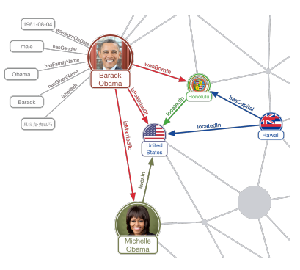
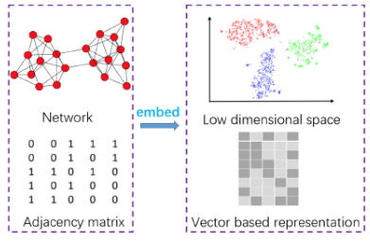
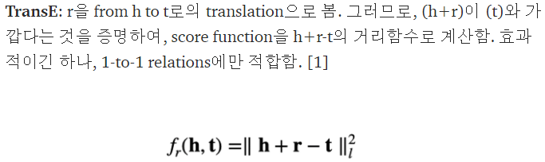
PROBLEM STATEMENT
Problem Formulation
Preliminaries Knowledge Graph : fact is represented as a triple (subject, relationship, object) Knowwledge Graph Embedding : automatic latent feature extraction and dimensionality reduction (TransE as the translational distance models)
An event at time ti is a Boolean predicate over the record ri, involving one or more attributes of ri.
: event e will occur soon aer r ∗ (or t ∗ ) if it is true in record (ri, ti) and 0 < ti − t ∗ < δ1, for a (small) constant value δ1. On the other hand, if e is false in each record (ri, ti) for ti ≤ t ∗ + δ2 (where δ2 > δ1 is a constant), we say that e happens long aer r ∗ (or t ∗ ).
δ1, δ2 are event timing gaps(count-based or time-based)

Slide 7
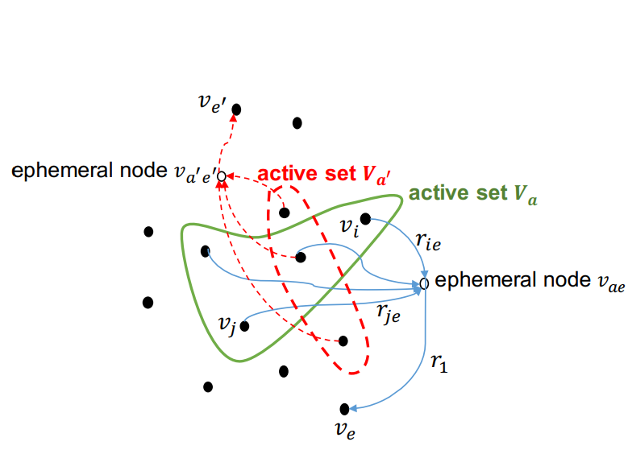
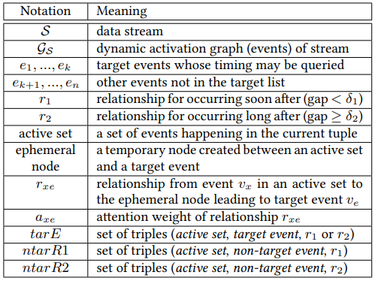
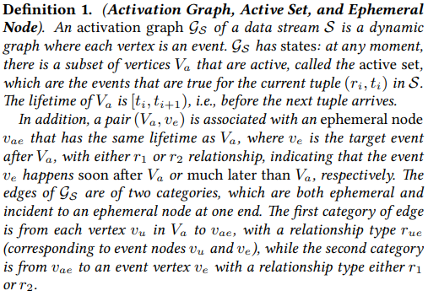
EVENT-TIMING GRAPHS AND STATE-BASED EMBEDDING
여러 주요 관련 이벤트(target event관점에서)를 vertices V으로 표현 timing 관계를 edges E로 표현 -> edge(event u, v)는 총 두가지의 타입 중에 하나 r1 = soon after, r2 = long after

Slide 8
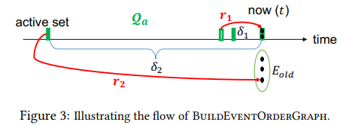
Graph Building Algorithm
Parse the training data window of stream S only once and construct graph GS
The r1 and r2 relationship-type edges(target edges) are added to GS
If algorithm is performed in real time and time remaining, the real-time embeedding is performed over non-target edges (reservoir sampling). (blue edges -> red edges)
We maintain a queue of active sets Qa from “now” (time t) back in time up to length δ2. In addition, we also maintain a set of events Eold that has not appeared for at least δ2 time. Then, as soon as an active set in Qa is δ2 old, we remove it from Qa and create r2 edges, one to each event in Eold. Furthermore, when the current tuple at time t (now) joins Qa, we also create r1 edges from each active set within δ1 back in time to each event in the current tuple.
Non-target event

Slide 9
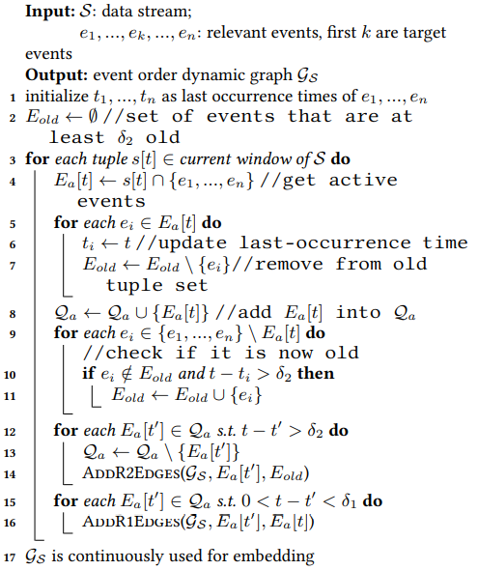
Algorithm 1: BuildEventOrderGraph
Line 1: initialize the last time of occurrence
Line 2: initalize a set that stores old events
Line 3-16: continuous and incremental parsing of the stream over sliding windows and deposits r1 and r2 edge information to the edge pool
----------------------------------------------------
Line 4: get the active set
Line 5-7: update each of these active events’ last occurrence time and remove it from the old set
Line 8: add the active set to a queue, trim the queue when an event is over δ2 old
Line 12-14: trim an active set from the queue if it is over δ2 old, add the corresponding r2 edges to each old event in Eold.
Line 15-16: add the r1 edges from each recent active set(within δ1) to each event in the current tuple.
Line 17: graph(edge pool)is continuously used by embedding algorithm

Slide 10
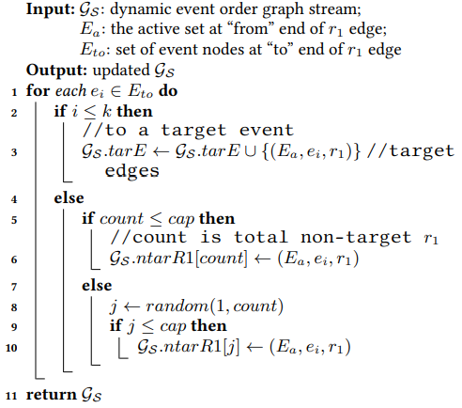
Algorithm 2: Add R1 Edges
Lines 2-3: If Eto is a target event, add the triple to the set of target edges(the set tarE).
Line 5-10: perform the reservoir sampling so the triple will be put in a fixed size buffer non-target r1 edges(ntar R1) uniformly.
-> creates hyperedges from an active set to a single event node

Slide 11
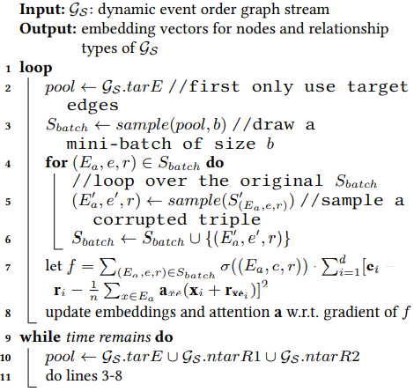
Algorithm 3: StateBasedEmbedding
Use data stream to obtain the graph embedding vectors. Extend the efficient TransE knowledge graph embedding algorithm and add ephemeral nodes as well as the attention parameters.
Line 1-8: perform the iterative training over target edges with higher priority
Line 9-11: same work on all edges
---------------------------------------------------
Line 3: samples a mini batch of triples
Line 5: Similar to TransE, does negative sampling by corrupting(변형) either the head or tail of a positive triple in the sample set
Line6: includes the negative sample in the batch
Line 7: key loss function of the embedding, where σ(·) function is the sign function that is +1 for a positive sample and −1 for a negative sample, and d is the dimensionality of the embedding vectors
Line 8: Algorithm does stochastic gradient desent optimization over each parameter value in each embedding vector and normalize them.

Slide 12
LEARNING RELEVANT EVENTS
Discuss how to identify “significant” events that help predict target events
-> tf-idf (term : each event candidates, document : context(tuples prior to target event, text corpuss : general context of the whole stream)
First, partition the set of values or value range of each attribute into basic events and composite events. -> find top-n events either basic or composite that have the highest tf-idf for each target event.
However, while the number of basic events is manageable, exponential number of composite events -> bitmap operations, sampling and A* style pruning and bounding.

Slide 13
LEARNING RELEVANT EVENTS
Bitmap operation
1) build a bitmap B1 for each basic event e where each bit of B1 corresponds to one occurrence of the target event, and the bit is 1 if e occurs within time [t − δ1, t), and is 0 otherwise. 2) build a bitmap B2 for each basic event e for its occurrence in the general stream context (i.e., every tuple). However, the problem is that there might be too many tuples in the stream, so we sample the stream tuples and each bit of B2 corresponds to a tuple that is chosen in the sample.
A*-style aggressive pruning and bounding
maintain a priority queue Q, where each element in Q is an event (basic or composite) along with a weight. pop out an event with the highest weight from Q, and expand it with another basic event unless it is marked finalized. A finalized event e has its weight exactly the same as its tf-idf, and since this value is higher than the upper bounds of the tf-idf of all other events in Q, it should be returned as a top event.

Slide 14
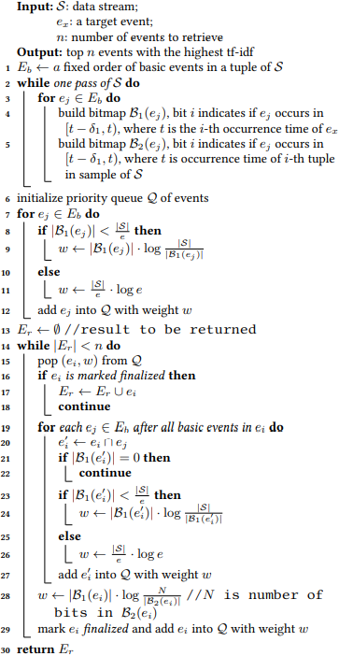
Algorithm 4: GetTopRelevantEvents
Line 1: assign an arbitaray but fixed order to all basic events
Line 4-5: build the two bitmaps
Line 6-29: perform the A* search on top-n events with highest tf-idf.
-------------------------------------------------------------------
Line 7-12: add each basic event into the priority queue Q
Line 9&11: set the weights used to orderr the items in Q
Line 15: pops the root of Q each time for the event with the greatest w(upper bound of tf-idf)
Line 16: marks that w is actually the exact tf-idf of the corresponding event ei
Line 17: adds ei into the set to be returned
Line 19-27: expand the current event ei by one more basic event ej
Line 23-26: set the upper bound value w Line 28: updates the w of the already popped out ei to its exact tf-idf value, and marks it as nalized before puing it back into Q

Slide 15
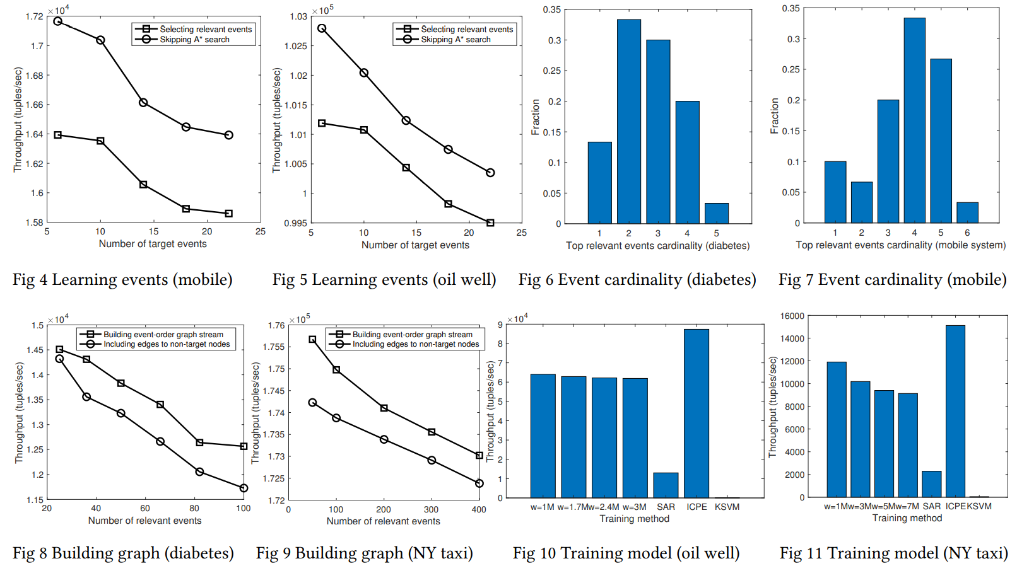
EXPERIMENTAL EVALUATION
The experiments are performed on a MacBook Pro machine with OS X version 10.11.4, a 2.5 GHz Intel Core i7 processor, a 16 GB 1600 MHz DDR3 memory, and a Macintosh hard disk.
Learning Top Relevant Events
: define target events that a user may be interested in, set δ1 and δ2
-> evaluate the GetTopRelevantEvents Algorithm(how many stream tuples it can handle per second) varying the number of target events
-> A* search decreases the throughput and it decreases as the number of target events increases (algorithm needs to proportionally handle more events)
-> examine the distribution of the discovered top relevant events(cardinality), which is the number of basic events that a discovered relevant event comprises
-> reflects a tradeoff in the cardinality of a relevant event. Having too few basic events gives a higher “tf”(각각의 basic 이벤트가 target events의 context에 나타날 확률이 높으므로), also lower idf(일반적인 stream context에서 자주 등장)

Slide 16
EXPERIMENTAL EVALUATION
Continuous Building of Event-Order Graphs
: examine the performance of building event-order graphs
-> performance decreases as the number of relevant events increases
-> including all edges to non-target nodes decreases the performance for building the graph (top relevant events does not need to be high to achieve accuracy)
-> throughput with tuples aggregated in shorter time is higher (NY taxi)
Embedding Training and Overall System Throughput
: measure the throughput of training with varing window size
-> throughput slightly decreases as window size increased (increasing window size -> decrease convergence speed(more tuples exhibit more variable latent features) -> global stability after some point)
-> this does not guarntee the better prediction accuracy (next page)
-> ICPE is faster than our method, but prediction accuracy is the worst

Slide 17
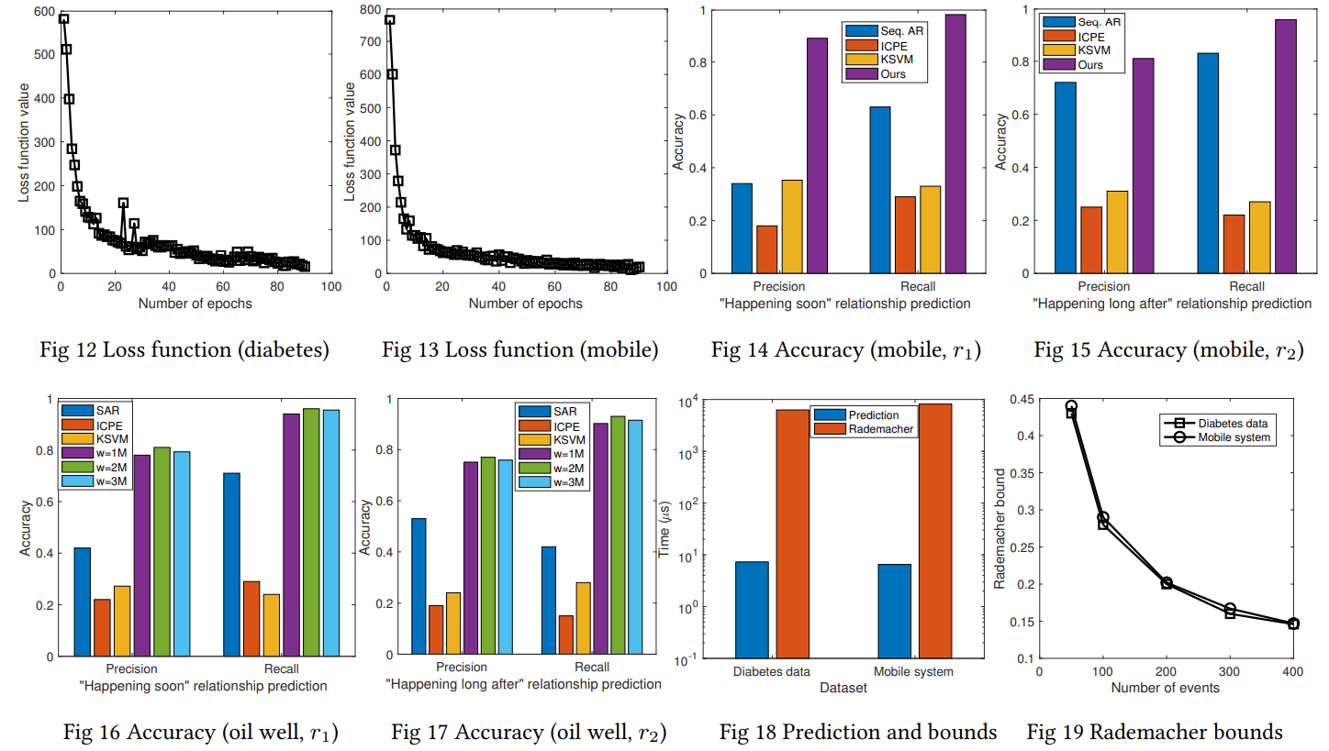
EXPERIMENTAL EVALUATION
Loss function
-> loss function values after each epochs (defined as a uniform random sample of edges of the same size as the total number of edges in the graph)
-> sharply decreases after each of the initial epochs of the embedding, where we perform stochastic gradient descent optimization
-> After 40 to 50 epochs, the loss function values in both figures level off, and converge at the lowest by around 80 to 90 epochs.

Slide 18
EXPERIMENTAL EVALUATION
Predictive Query Accuracy
: examine the event prediction accuracy
-> parse the test data and for each distinct active set of events, record the set of target events that have r1 or r2 relationships, then calculate the precision and recall values when using our trained embedding vectors and attention values for prediction.
-> our method is much more accurate than the three baseline methods, achieving good precision and recall values
-> initial increase of window size can improve precision and recall accuracy, further increase beyond a certain point actually decreases the accuracy (recent data is more accurate for training the current model)
-> the recall accuracy values are higher than precision values (ground truth from knowledge graph are incomplete, so it can miss some real targets for a relationship -> precision slightly suffers)

Slide 19
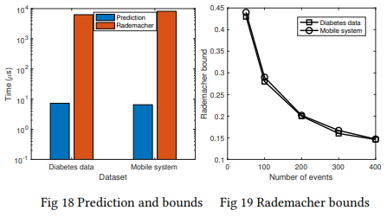
EXPERIMENTAL EVALUATION
Training Data Dependent Complexity Bounds
: implement the computation of the data-dependent accuracy bounds using Rademacher complexity
-> making a prediction is very fast (as the model embedding is already trained), while computing the Rademacher bound is longer (mostly due to the gradient descent optimization)
-> the error bound decreases as the sample size increases, and the average bounds from the two datasets are close

Slide 20
Summary of Results
Learning the top relevant events for a set of target events using A* search is quite efficient, and the cardinality of the top events typically rnages from 2 to 5
Fast convergence of the loss function value after around 50 epochs during the training
The overall system throughput for graph building, embedding training, and event prediction ranges from over one thousand to sixty thousand tuples per second
Precision and recall values ranges from around 0.7 to nearly 1, much higher than those of the three basline methods(SAR, ICPE, KSVM)

Slide 21
CONCLUSION
Propse a novel approach to predict event timing information in multi-attribute data streams
Represent the event timing knowledge in training data using a knowledge graph
The notion of ‘active state’, ‘ephemeral nodes’, ‘attention parameters’
Achieve high precision and recall values in predicting event timing, outperforming baslien approaches

